Slide 1

Department of Computer Science, Maharaja KrishnaKumarsinhji Bhavnagar University
The Agro World
Submitted BY:- Sheetal Moradiya

Slide 2
Project Outline
Introduction
Project Profile
Use case Diagram
Activity Diagram
Screen Shots
Future Enhancement
Conclusion
Bibliography

Slide 3
The Agro World system provides its users and researches to get online information about the crops, statistical details and increase products.
The Agro World System which will allow formal and informal Farmers, Wholesalers and Vendors to purchase and sell their products on the internet.
There are multiple types of users available in the project:
Admin : With Full Access
Farmers : With Limited Access
Wholesaler : With Limited Access
Grocery Store : With Limited Access
Client : With Limited Access

Slide 4
Project Title | The Agro World
Company Name | ADITE Technologies
Development Tools | WAMP Server
Operating System | Windows based Operating System
Programming language and Scripting language | PHP, HTML, CSS, JavaScript,JQuery
Database | MySQL
Internal Guide | Mr Amit Hariyani
External Guide | Mr Vipul Jikadra
Project Duration | 15-Jan-2018 to 25-Apr-2017
Developed By | Moradiya Sheetal V.
Submitted To | Department of Computer Science, Bhavnagar

Slide 5
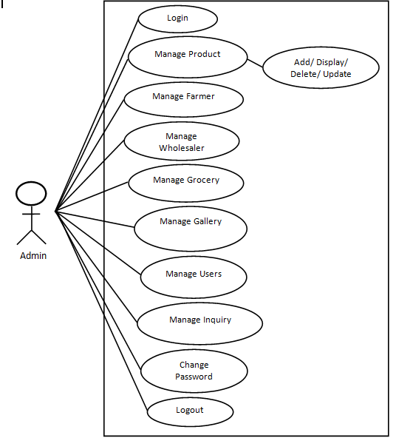
Use Case Diagram of Admin

Slide 6
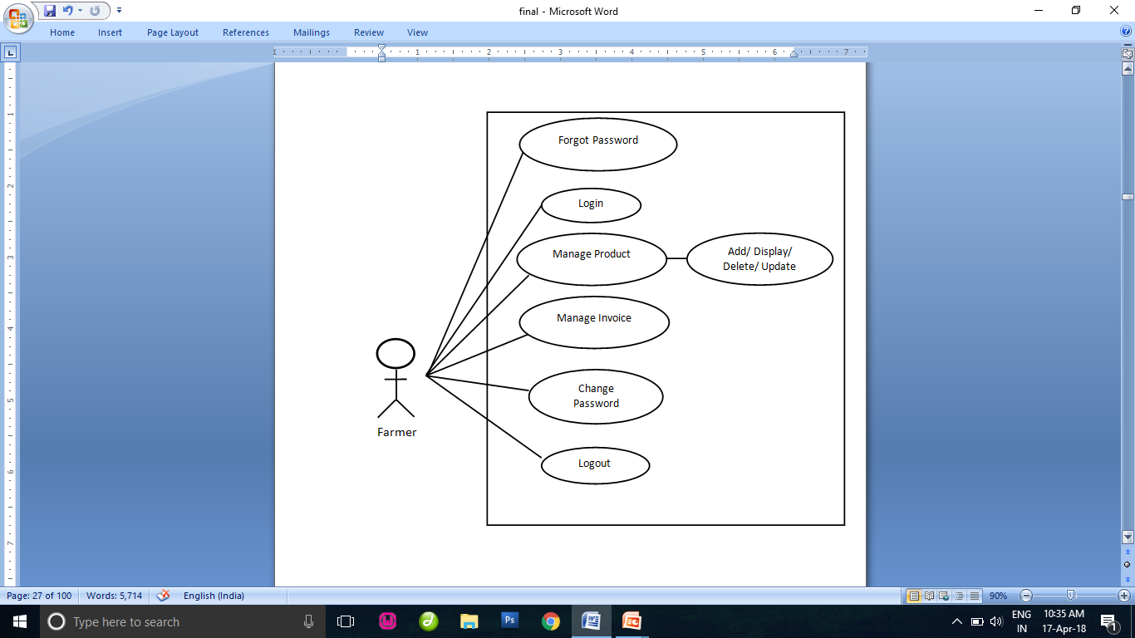
Use Case Diagram of Farmer

Slide 7
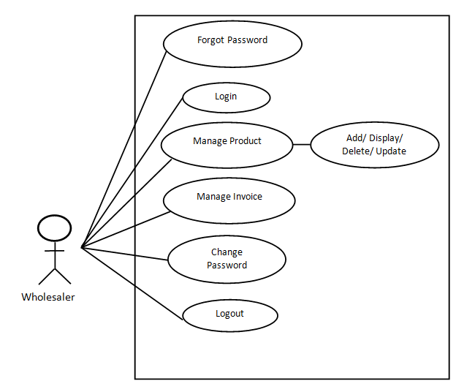
Use Case Diagram of Wholesaler

Slide 8
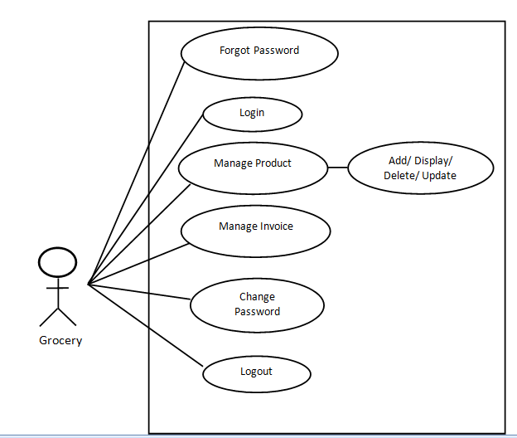
Use Case Diagram of Grocery

Slide 9
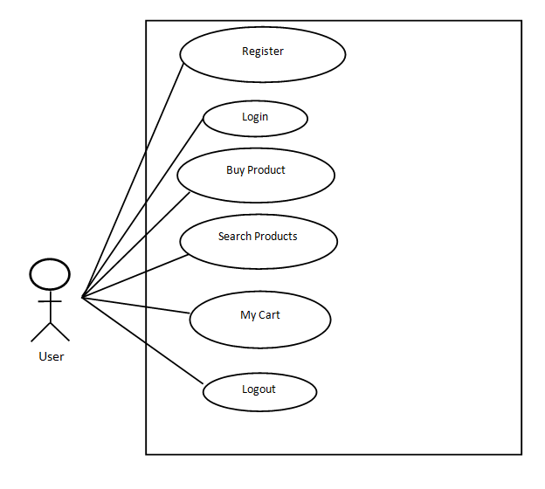
Use Case Diagram of User

Slide 10
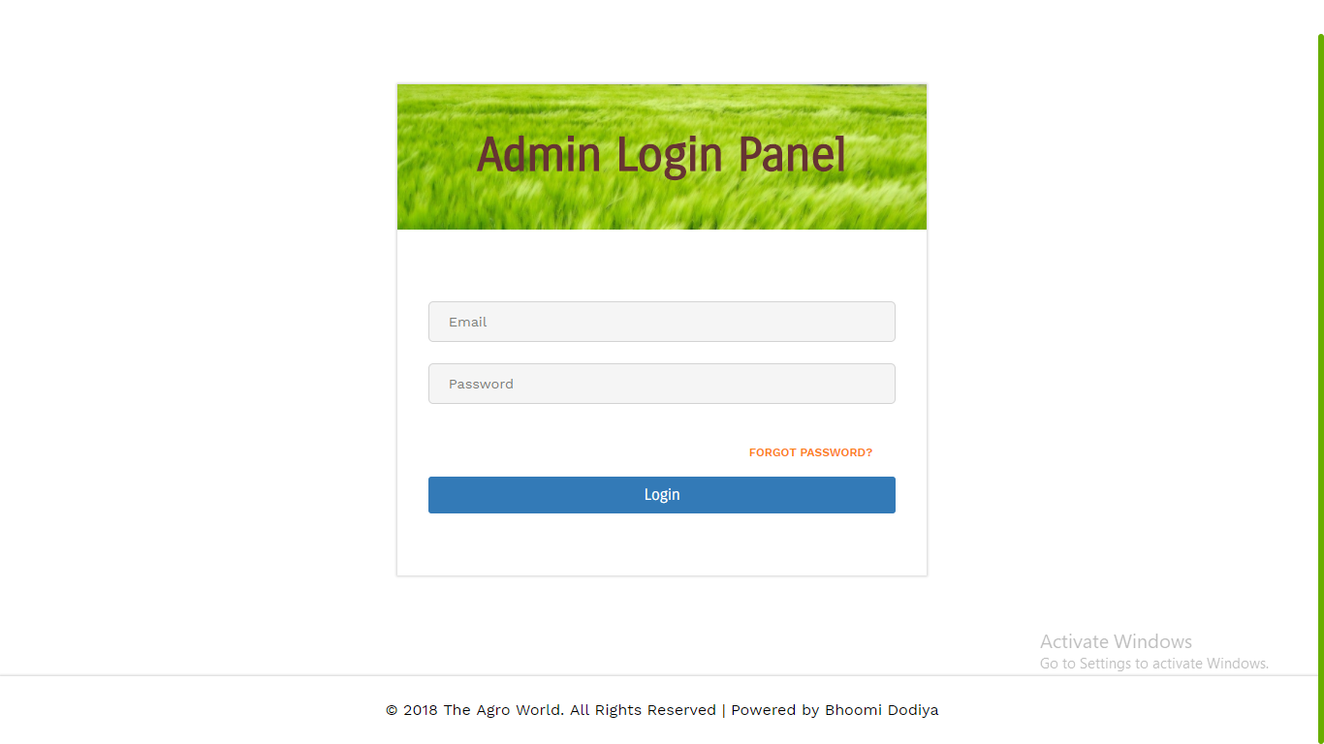

Slide 11
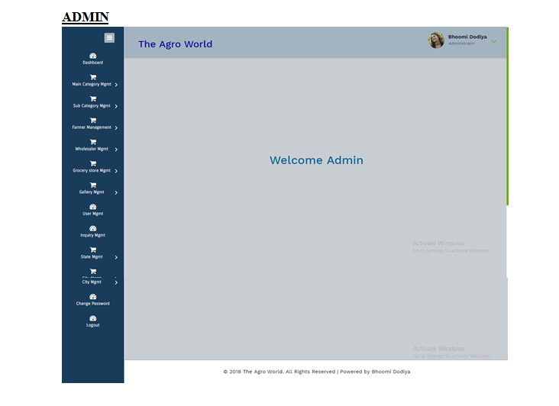

Slide 12
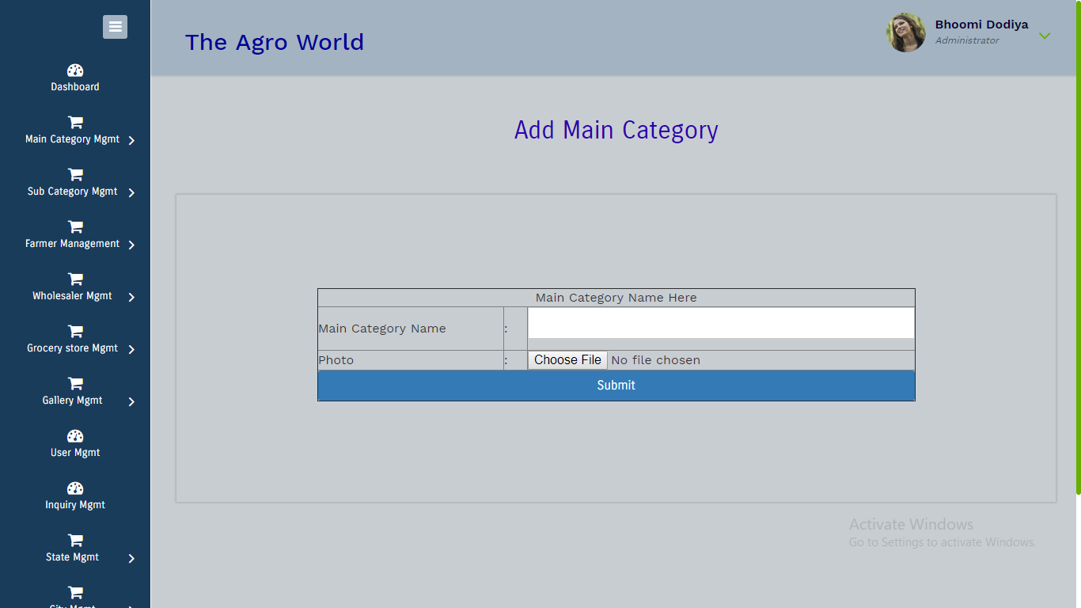
Add Main Category

Slide 13
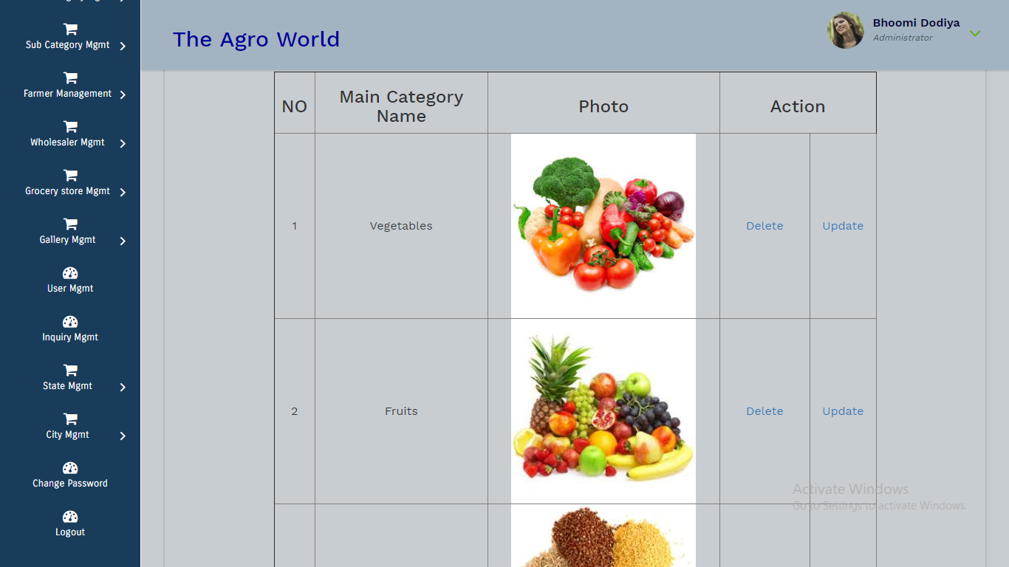
Show Main Category

Slide 14
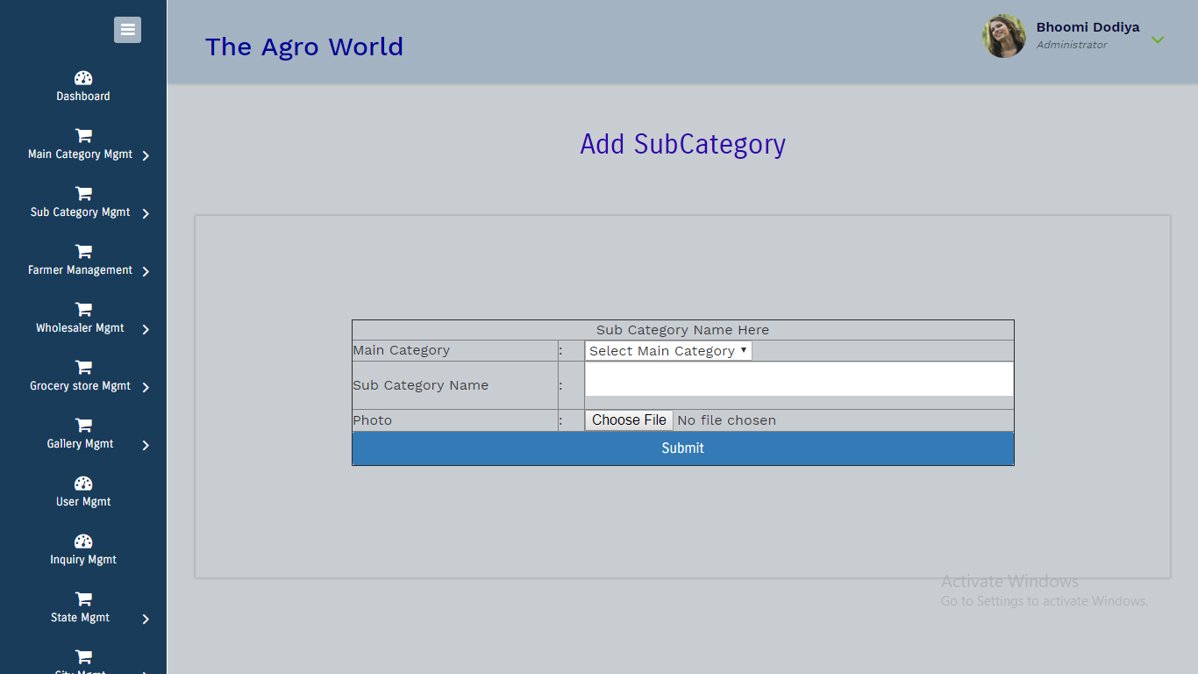
Add Sub Category

Slide 15
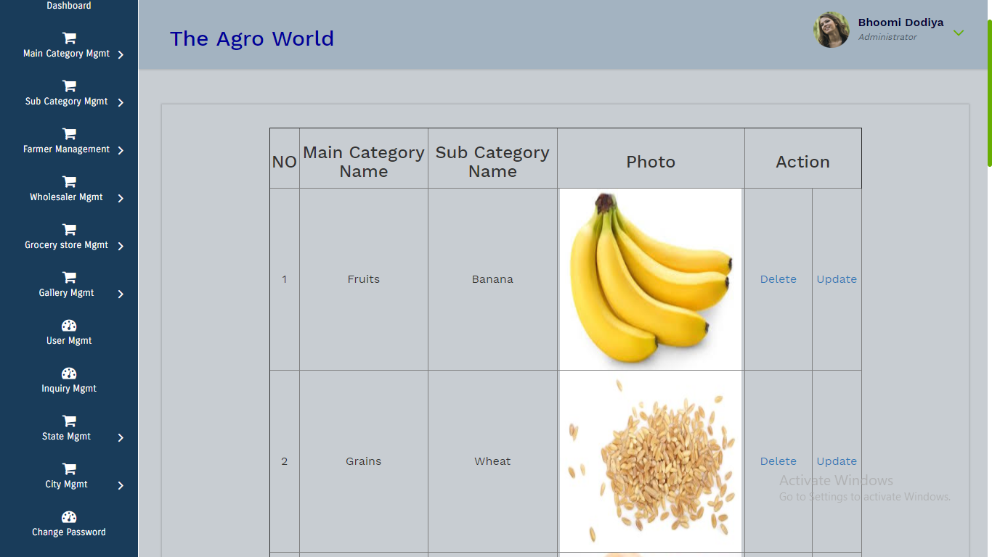
Show Sub Category

Slide 16
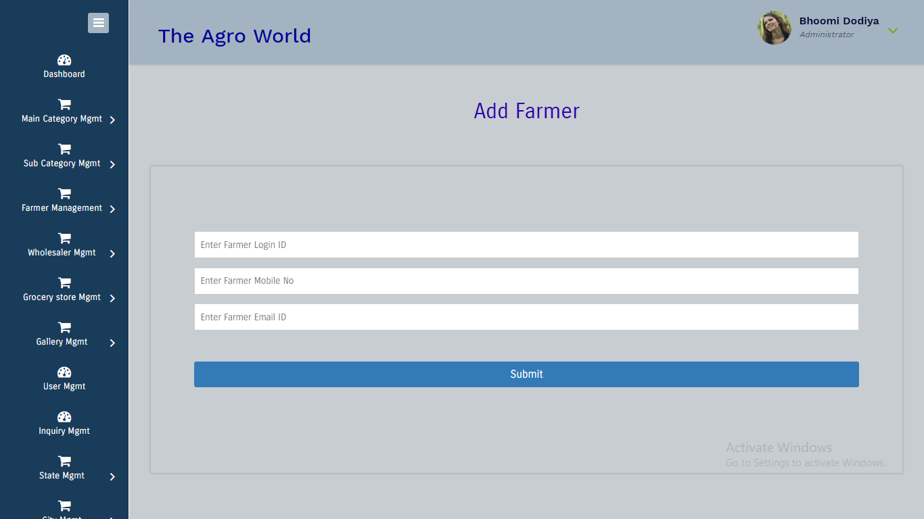
Add Farmer

Slide 17


Add Wholesaler
Add Grocery Store

Slide 18
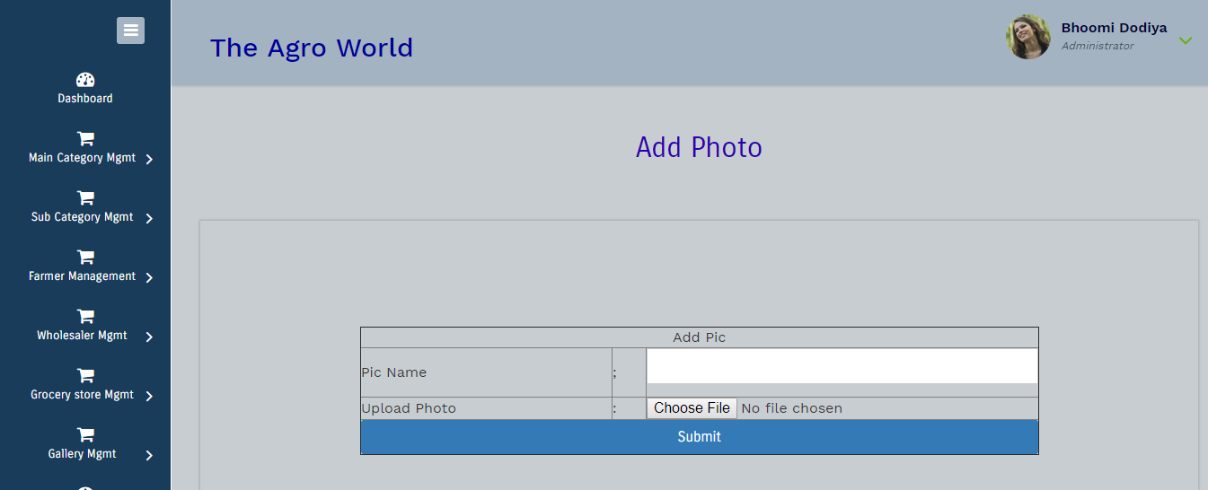
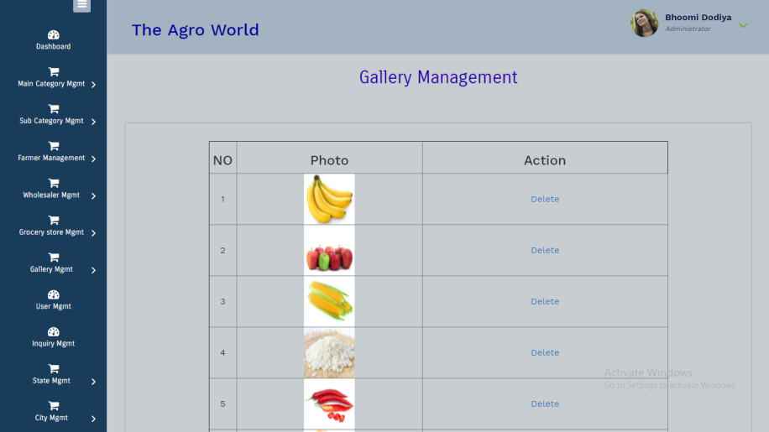
Add Gallery
Show Gallery

Slide 19
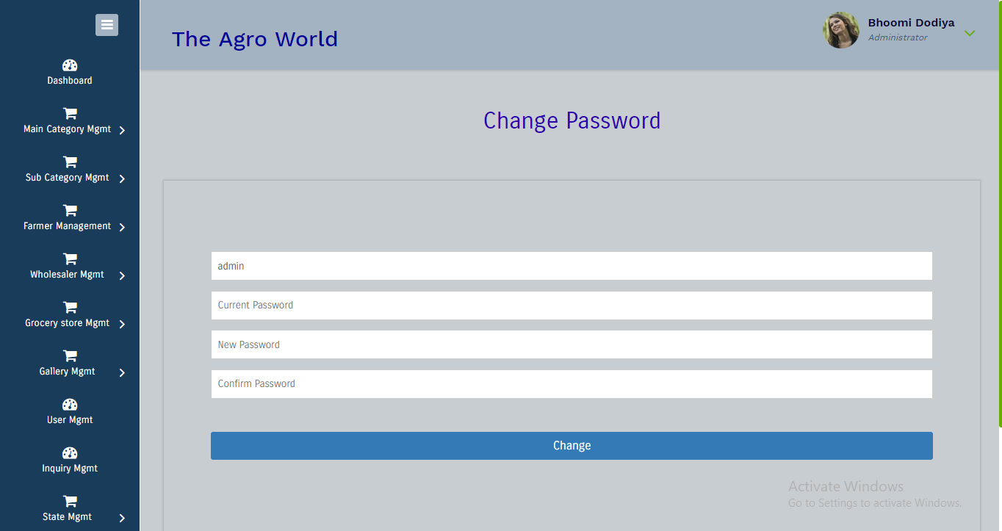
Change Password

Slide 20
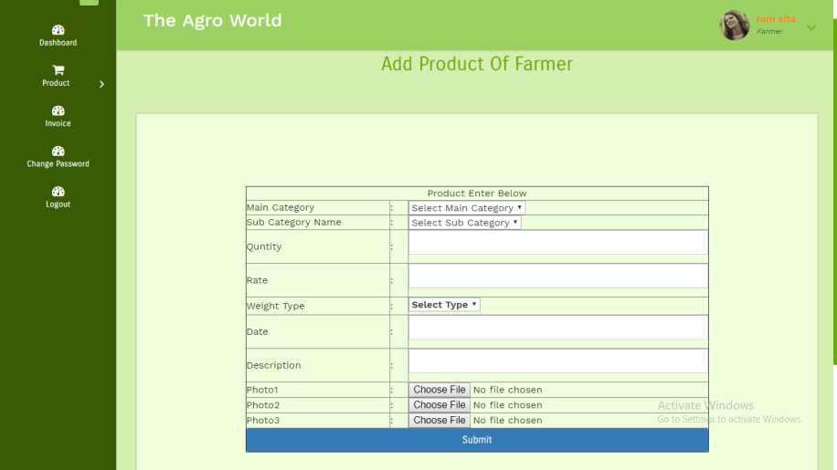
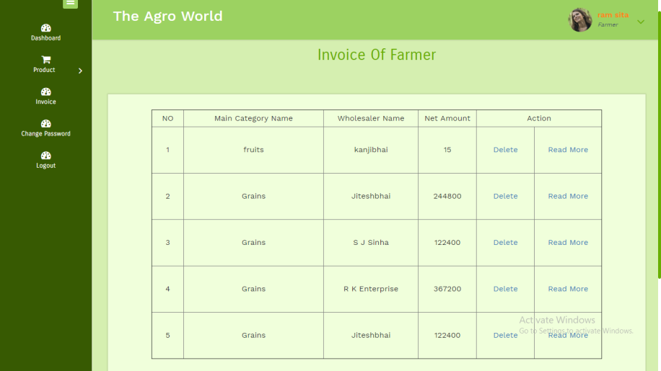
Add Product of farmer
Invoice Of Farmer

Slide 21
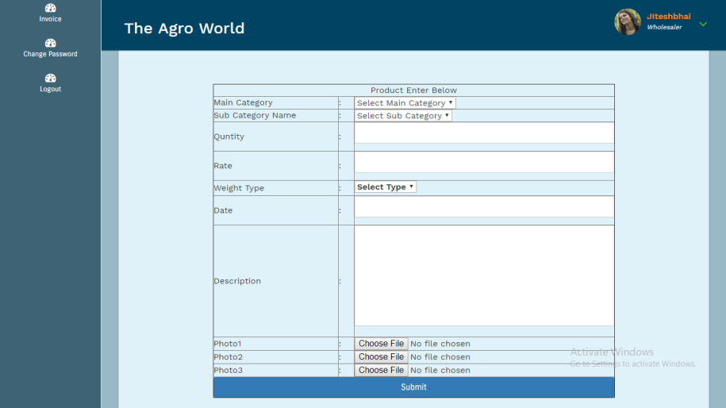
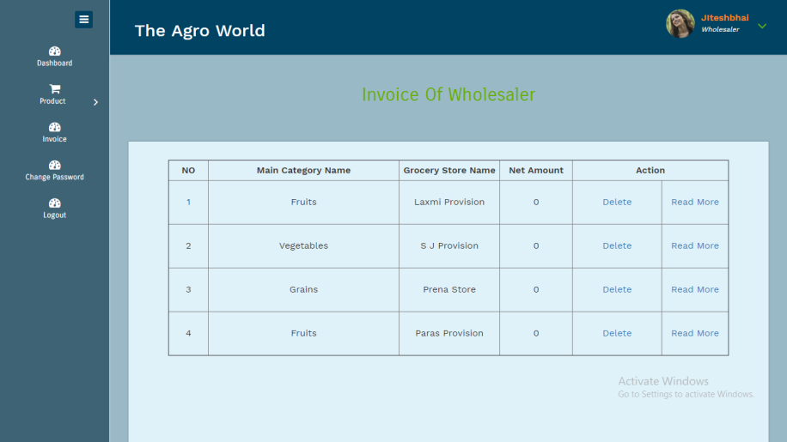
Add Product Of Wholesaler
Invoice Of Wholesaler

Slide 22
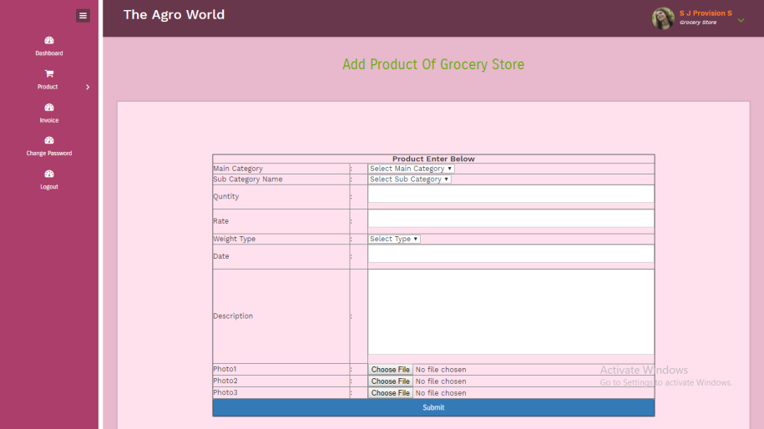
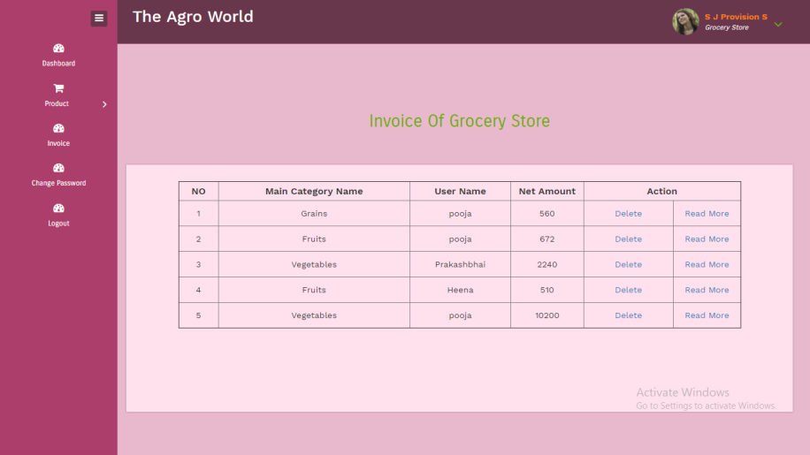
Add Product Of Grocery Store
Invoice Of Grocery Store

Slide 23
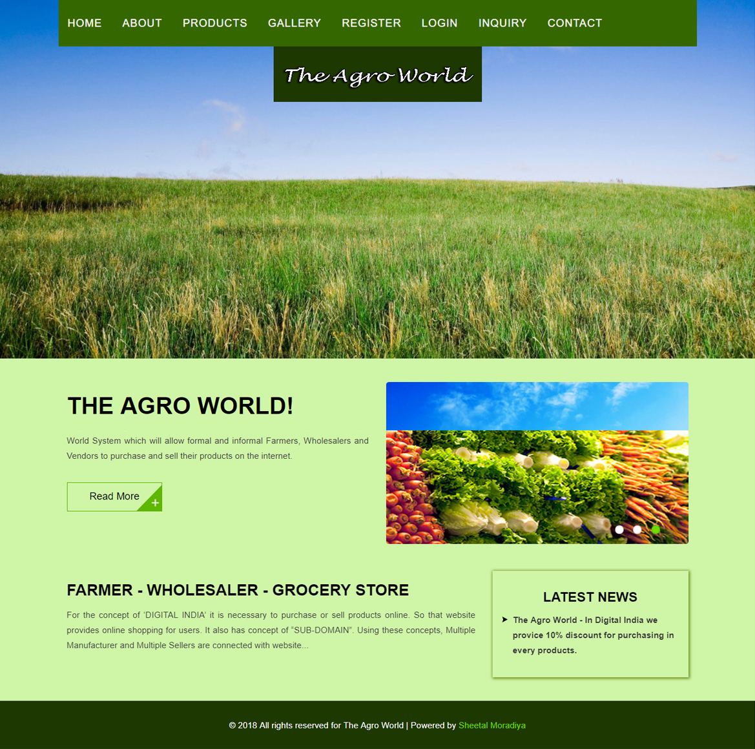
Home

Slide 24
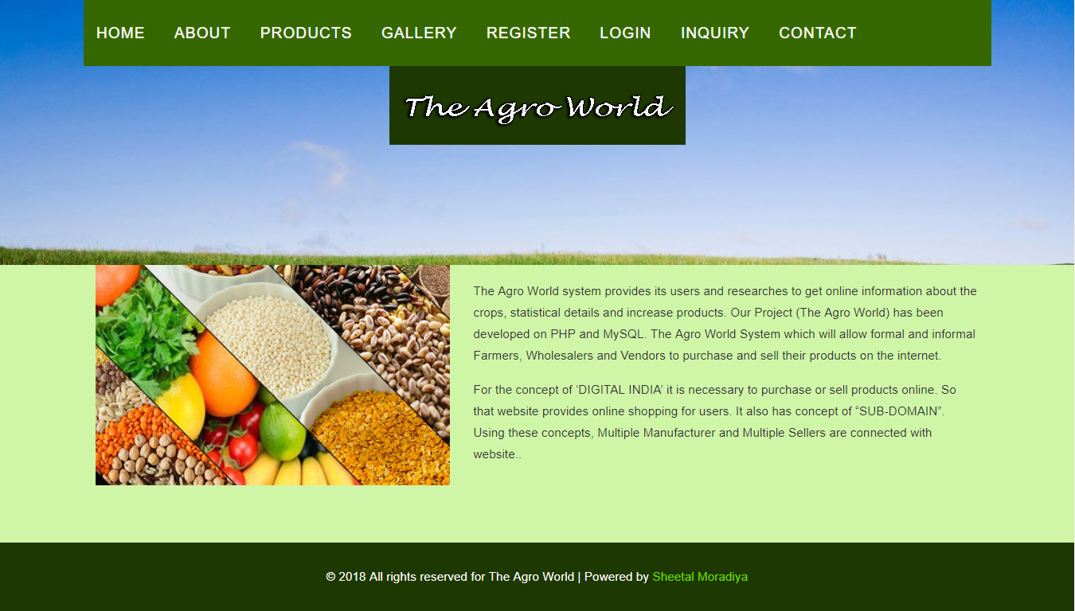
About

Slide 25
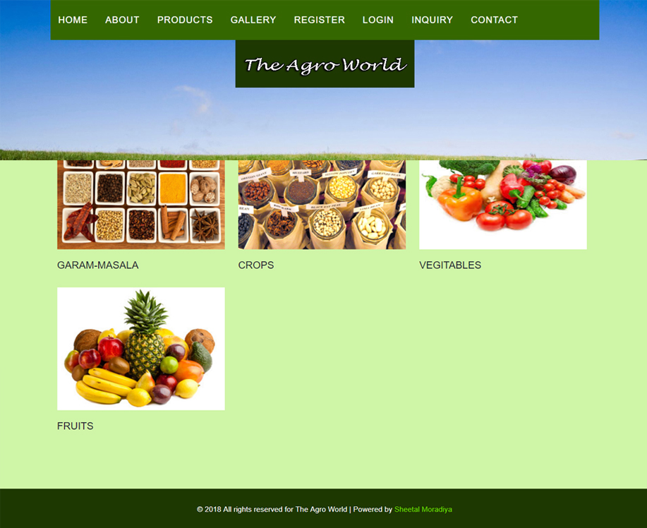
Products

Slide 26
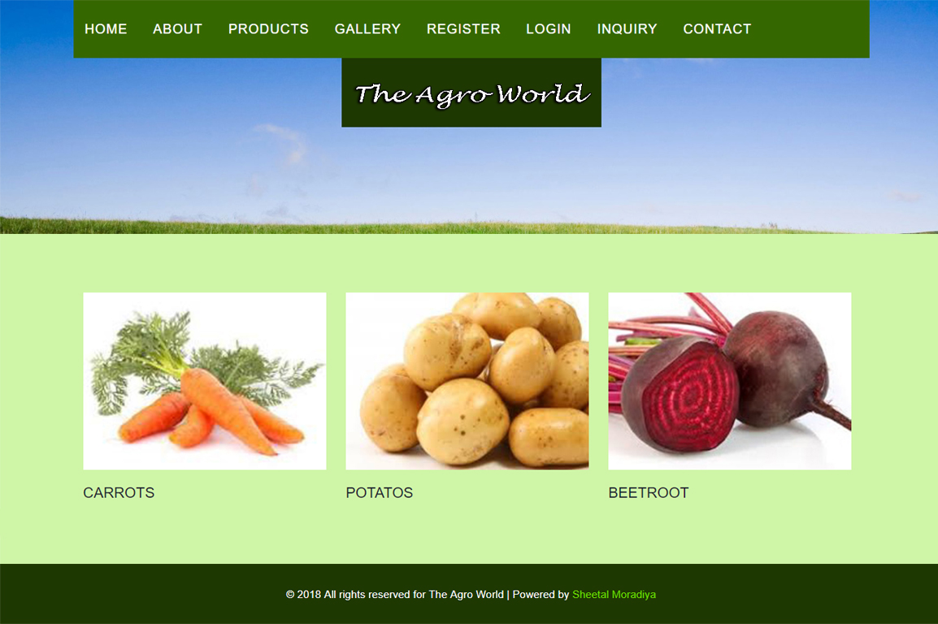
Sub Products

Slide 27
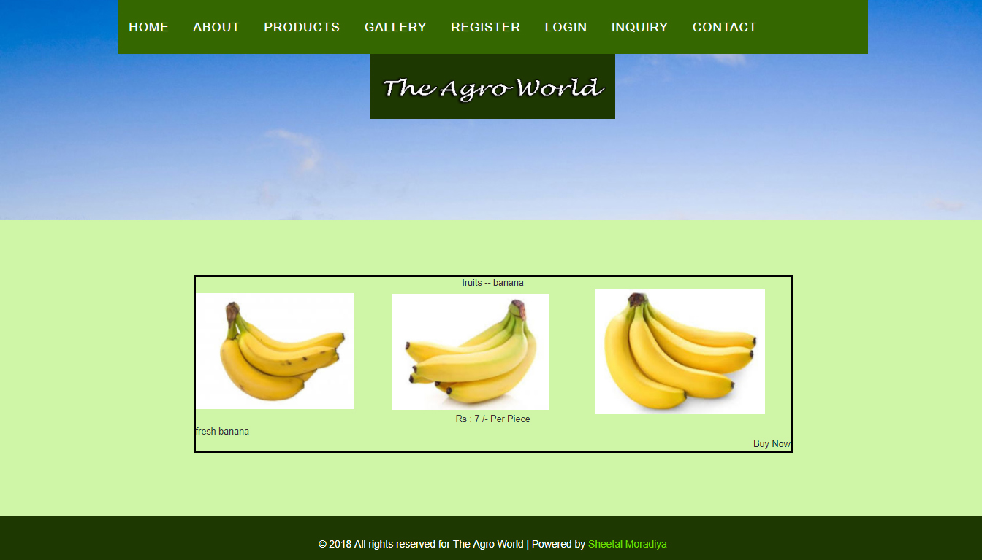
Products Details

Slide 28
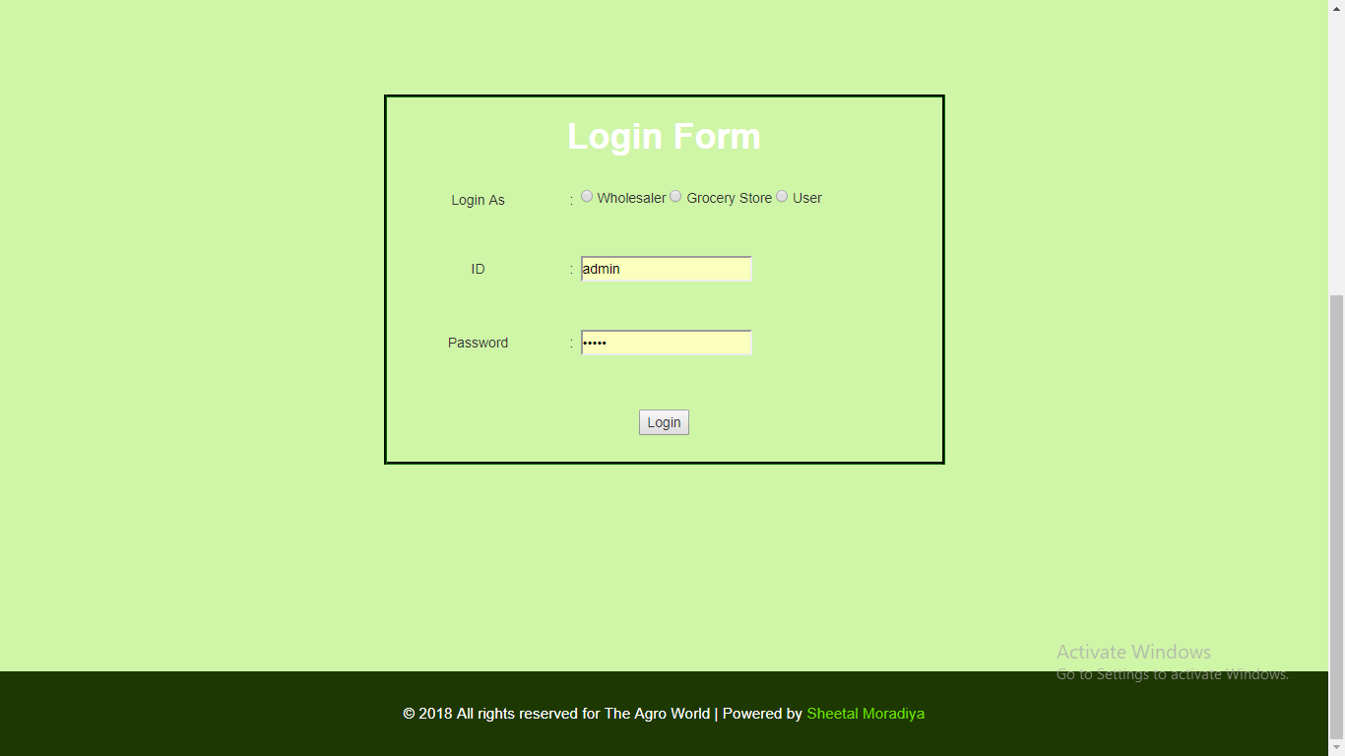
Login

Slide 29
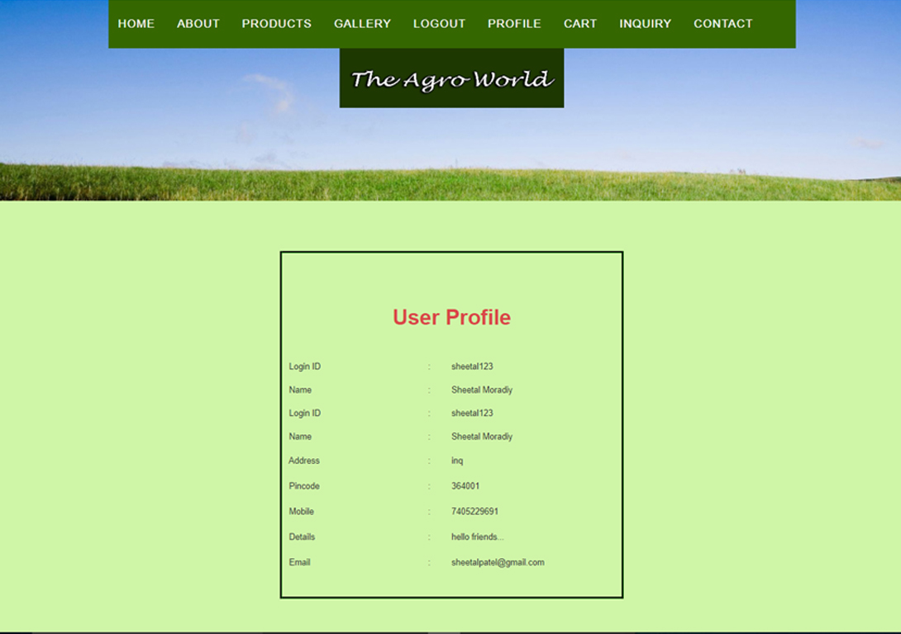
Profile

Slide 30
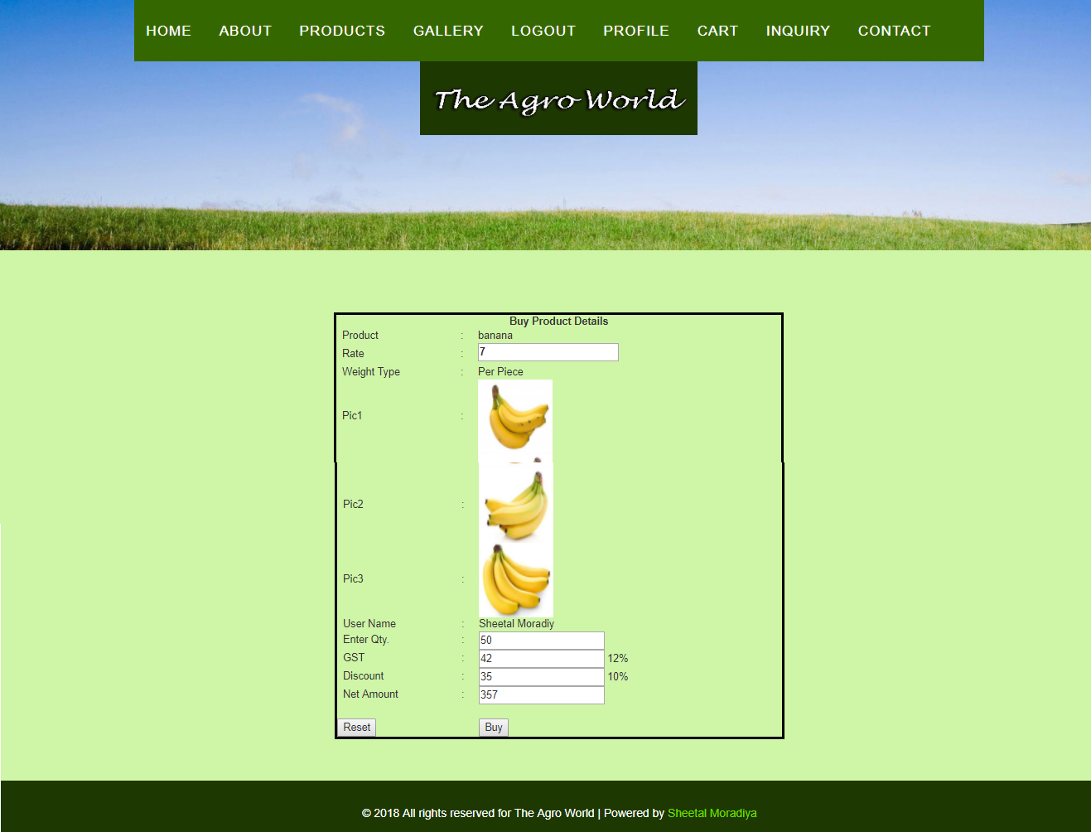
Buy Product

Slide 31
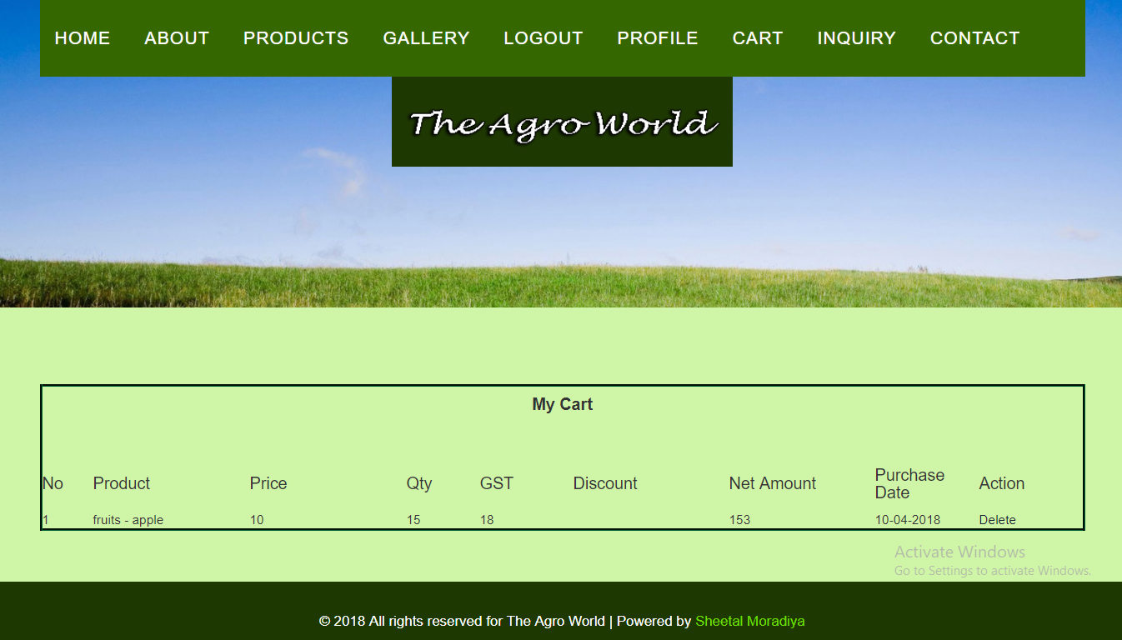
Cart

Slide 32
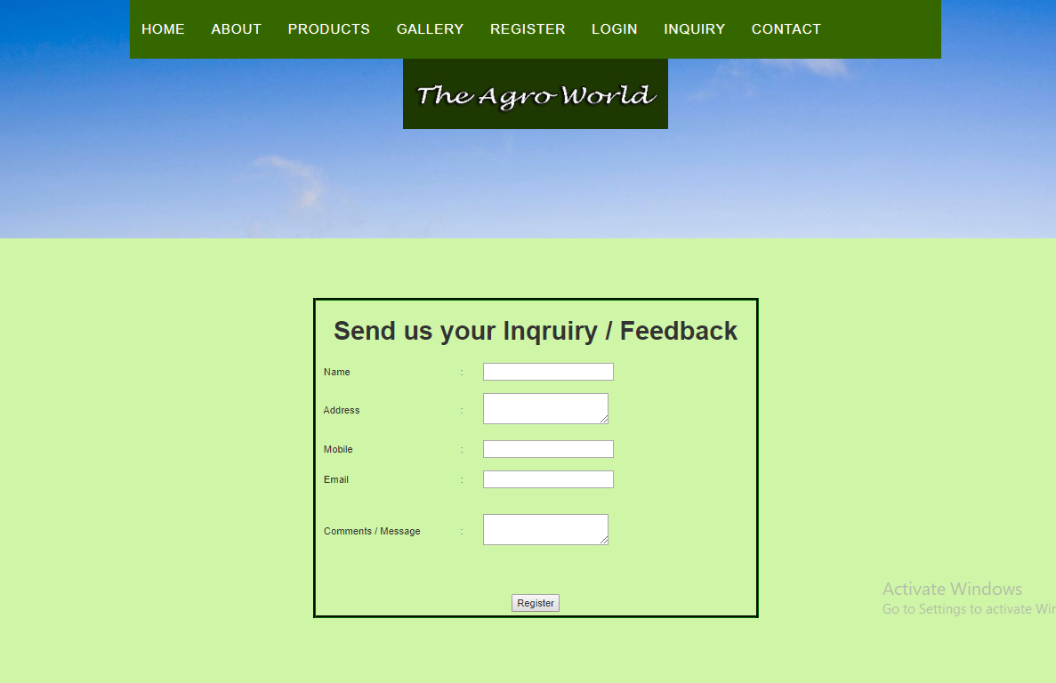
Inquiry

Slide 33
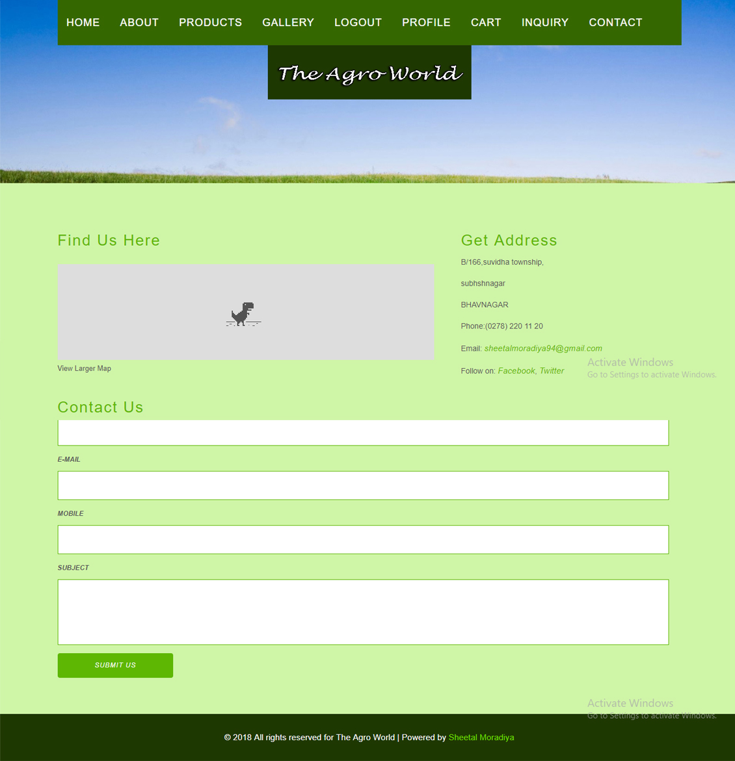
Contact

Slide 34
Future Enhancement
In future mobile application could by done by us on requirement of user. A mobile integration could be done. Here the user of the site would be notified of any development of his request or any job opportunities on directly his mobile phone.
Right now, only mail sending is possible but in future requirement of User and Sub Admin with single & multiple message facility also available in our project.
In further requirement bill printing facility also integrated within it.
In future not only Indian but international companies and aspirants could be added to the site for a broader opportunity level for both the parties.
In future not only Indian but international companies and aspirants could be added to the site for a broader opportunity level for both the parties.

Slide 35
Conclusion
In the beginning the project seemed to be just one another subject that we needed to pass in order to get a through my semester. But with passing time and with each passing day (even nights!), we found the development of this project became a great learning process.
We had to complete the project in time and in budget. It was very important that we got proper information from the end-users in order to provide them with a fully functional and simple enough to understand system. That helped us to learn how to deal with people of different temperament and opinions.
All in all this entire project has prepared us fully for what we are going to face in the IT field in future. And we are very thankful for that.

Slide 36
Bibliography
Web Resources www.google.com www.w3schools.com www.easyphp.org www.wikipedia.com | Books PHP Manual Authors - Stig Saether Bakken Alexander Aulbach Egen Schmid Jim Winstead Lars Torben Wilson Rasmus Lerdorf Andrei Zmievski Jouni Ahto

Slide 37


